Slide 1






💡 A simple but powerful way to expand text, launch files, fill forms, and save time on repetitive tasks.
www.youtube.com/@InstantAutomate
instantautomate@gmail.com

Slide 2



What is Magic Quick Typer ?
💡 Smart Text Expander
📂 File and Folder Launching
⚡ Auto Form Filler
Transform tiny shortcuts into full sentences, emails, or even paragraphs instantly. You can also assign shortcut keys to expand text quickly whenever you need.
Open files, folders & apps with just one keystroke !!
Auto-fill repetitive forms and emails instantly. You can even assign shortcut keys
⌛ Typing Delay Support
Excel Customization
Perfect for remote or legacy apps.
Seamless Typing with Adjustable Delays on Remote Desktops Applications.
Everything is managed through Excel. Just add your shortcuts, and you’re ready to go.
Available in both .exe and .ahk file formats for maximum flexibility and compatibility.

Slide 3

Set up your Shortcuts.xlsx file
Short Text
1
2
3
4
Type :
Choose Hotstring for short text expansions
Hotkey for keyboard shortcuts.
Shortcut Key
Assign keys like Ctrl + W for Hotkeys, or short text like Gm for Hotstrings.
Shortcut Key
(Ctrl+W)
1
3
Symbol codes:
^ = Ctrl,
! = Alt,
+ = Shift
Name :
This is simply a label, so you can easily identify your shortcut.
Your Actions Here
This is the actual message that gets typed instantly.
2
4
Simple four-column structure makes customization intuitive and straightforward for any user.

Slide 4
Updating Your Shortcuts
1
Exit Script
Right-click tray icon → Exit to stop current session
2
Edit Excel File
Open Shortcuts.xlsx and modify your shortcuts and Expanded text
3
Save Changes
Save and close Excel file to preserve your updates
4
Relaunch
Start Magic Quick Typer again - new shortcuts ready instantly!
The entire update process takes less than a minute, making customization effortless.

Slide 5
Hotstring & Hotkey Rules
Hotstrings (Short Text)
Hotkeys (Shortcut Key)
gm → Good Morning!
*abc → Your Custom Text
^r → Ctrl + R → Your sentence
!+R → Alt + Shift + R → Your sentence
Press Shortcut anywhere Ctrl + R or Alt + Shift + R
To expand Text instantly
Type anywhere (gm or *abc)
To expand text instantly
Modifier Symbol codes: ^=Ctrl, !=Alt, +=Shift
Combine modifiers for powerful keyboard shortcuts that trigger your custom text expansions.

Slide 6

Hotstring & Hotkey Rules
Folder And File Opening :
File Path Format : Run "Replace Your Full File and Folder Path Here"
For File Open : Run "C:\Users\Tnka-Laptop\Downloads\convertcase-net.txt"
For Folder Open : Run "C:\Users\Tnka-Laptop\Downloads\"
* Need To Give Space Between RUN and File and Folder Path With Double quotation marks
Modifier Symbol codes: ^=Ctrl, !=Alt, +=Shift

Slide 7

Hotstring & Hotkey Rules
Delayed Text
Format :
DE500 Your Action Text
* Need To Give Space Between DE500 and Your Action Text
DEXXXX - XXXX Is your Time in Milliseconds
DE500 - 0.5 Second Delay Between Each Characters Typing
DE1000 - 1 Second Delay Between Each Characters Typing

Slide 8
Built-in Functions
Ready to Use - No Excel Setup Required
These functions work immediately without any Pre Setup needed.
Date Insertion
--d → 26-08-2025
Instantly adds current date in DD-MM-YYYY format
Time Insertion
--t → 03:10:04
Instantly adds current time in HH:MM:SS format

Slide 9

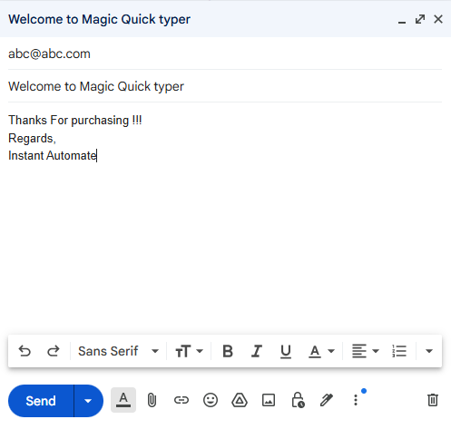
Hotstring & Hotkey Rules
Form Filling :
Form Filling Instructions
You can insert special keys such as
{Enter}, {Tab}, {Up}, {Down}, {Left}, {Right}, {Space}
anywhere within your text to move through Input Text Box
fields or control navigation as needed.
Use Delay Function if you needed
For Selecting Dropdown Menus and Etc
Format : DE200 Your {Enter} Action {Tab} Text
*** ⚠️ Note: Some applications may not fully support automated form filling.

Slide 10





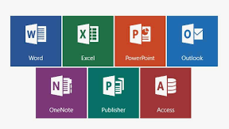

Universal Application Support
Magic Quick Typer works seamlessly across any application on your Windows system
Web Browsers
Chrome, Edge, Firefox, Opera, and all modern browsers
Email Clients
Outlook, Thunderbird, webmail, and messaging apps
Office Applications
Microsoft Word, Excel, PowerPoint, and text editors
Form Filling
Online forms, registration pages, and data entry tasks
Works everywhere - no application restrictions or compatibility issues!

Slide 11
Simple Installation Process
1
Download from GitHub
Get the repository and extract the ZIP file to your desired location
2
Choose Your Method
Run Magic Quick Typer.exe directly - that's it! OR run the .ahk file
3
Optional: Install AutoHotkey v2
Only needed if running .ahk files - download from official AutoHotkey website
4
Start Typing!
Begin using your shortcuts immediately across all applications

Slide 12
Thanks For Watching
Thank You!
“ யாம் பெற்ற இன்பம் பெறுக இவ்வையகம் "
"Let the world enjoy the happiness we have experienced"
Start automating your typing today with Magic Quick Typer!
Contact: instantautomate@gmail.com

Slide 13


💡
Magic Quick Typer
Turn Shortcuts into Full Sentences Instantly

